Slide 1
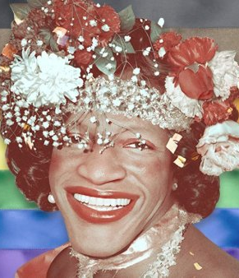
Marsha P. Johnson
Stories of Excellence
Student Health & Human Services
Office of Human Relations, Diversity & Equity
July 2022

Slide 2
Welcome
Do you prefer
Winter or Summer?
Winter
Summer
Notes:
Invite the students to participate in the warm up question.

Slide 3
Objectives
Learn about the life of Marsha P. Johnson.
Discuss Marsha P. Johnson's life work fighting for LGBTQ+ rights.
Reflect on the impact of Marsha P. Johnson's life on the queer community.
Notes:
Read the slide aloud for the students.

Slide 4
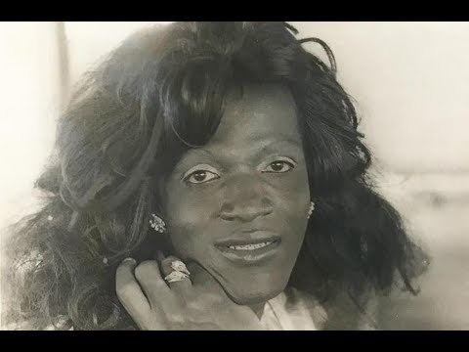
Introduction to Marsha P. Johnson.
Notes:
Play the video for the students (2:40).
https://youtu.be/NW5BIAKeGUg

Slide 5
Early Life
Marsha P. Johnson was born in 1945 and designated male at birth.
Marsha had 6 siblings and was raised in the African Methodist Episcopal Church.
Marsha first started wearing dresses at age 5, but stopped because she was made fun of by other children.
When Marsha was small, she remembered hearing her mother say "being gay is like being lower than a dog".
Feeling unwelcome at home, Marsha left for New York City at age 17 with $15 and a bag of clothes.
Notes:
Read the slide aloud for the students.

Slide 6
Reflect
Marsha experienced discrimination from an early age.
Do you think Marsha left home due to the discrimination she was experiencing?
Notes:
Invite the students to engage in reflection.

Slide 7
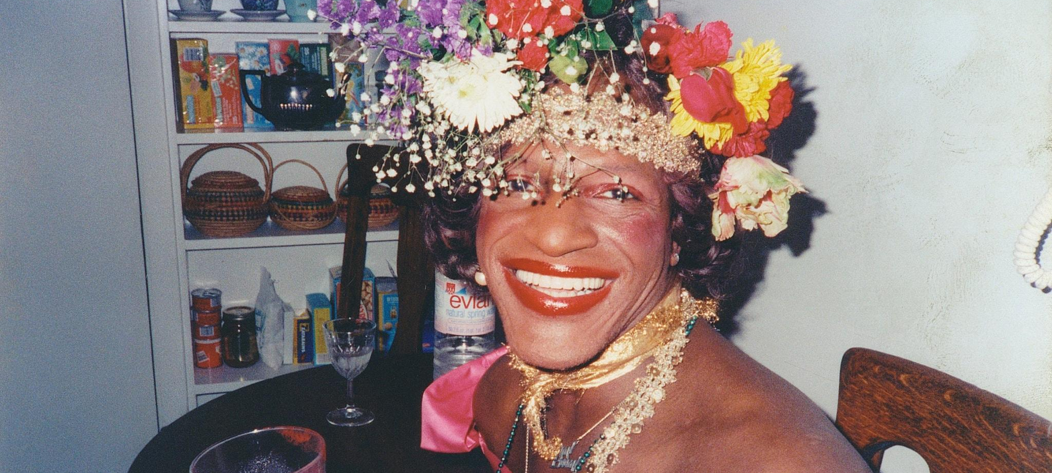
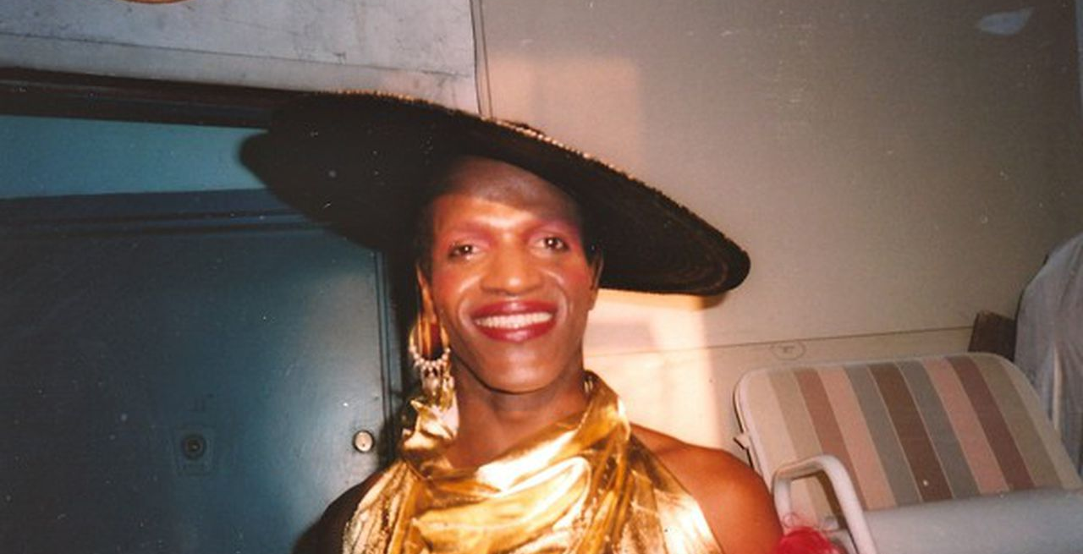
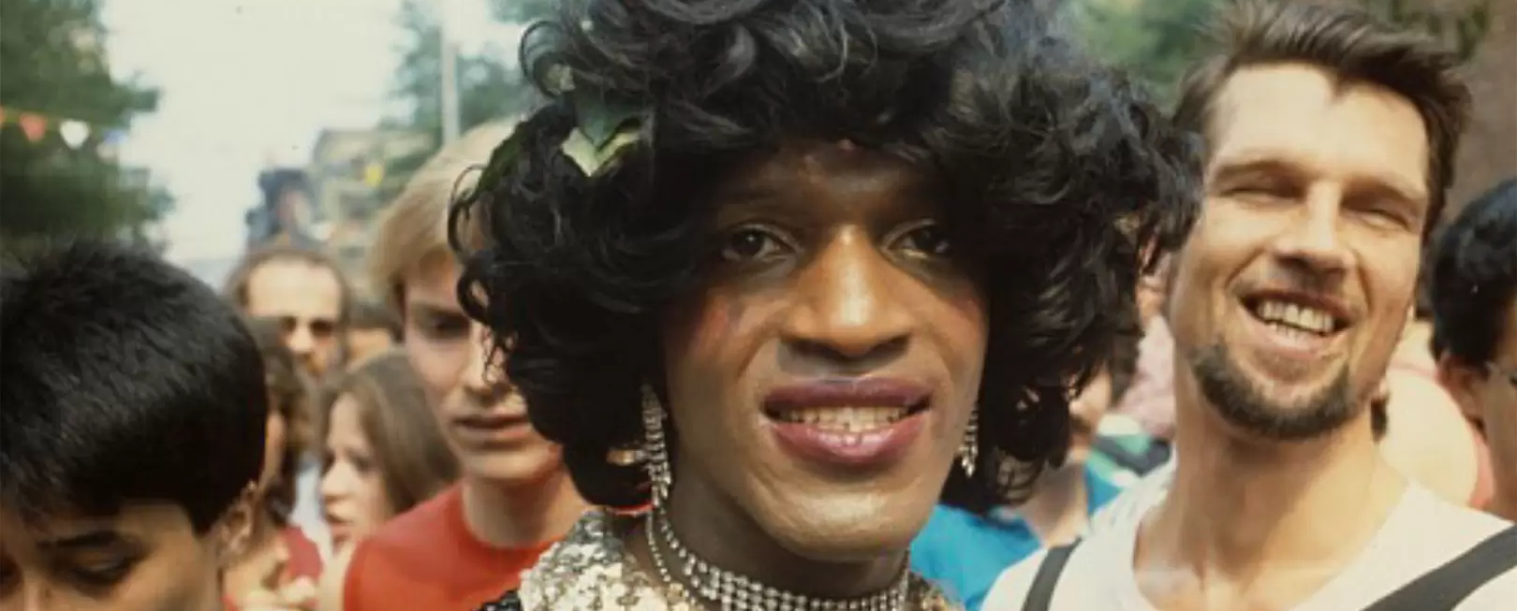
Life in NYC
In 1966, Marsha moved to Greenwich Village and started waiting tables to get by.
At this time, Marsha began engaging with other people within the LGBTQ+ community and began permanently using the name Marsha P. Johnson.
Marsha identified as gay, as a transvestite, and as a drag queen.
Often, Marsha could be seen dressed in flowing robes or shiny dresses, bright wigs and crowns of fresh flowers.
Marsha often found work performing as a Drag Queen and even performed with famous acts such as Hot Peaches and The Angels of Light.
Notes:
Read the slide aloud for the students. Emphasize for the students that the terms TRANSGENDER and GENDER NON CONFORMING were not highly utilized during this time, which is why Marsha identified as a transvestite and a drag queen. At the present time, the term “transvestite” is outdated and considered derogatory. Remind the students.

Slide 8
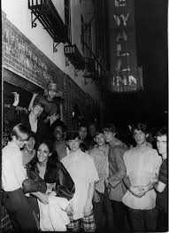
Stonewall Riots
Marsha is often credited as one of the instigators of the Stonewall Riots.
Marsha was one of the first drag queens to go to the Stonewall Inn, which has previously been a bar for only gay men.
However, the bar was heavily policed and patrons were regularly harassed by police
On June 28, 1969 the bar patrons finally pushed back and rioted against the continued harassment by the police towards the LGBTQ+ community.
Notes:
Read the slidea loud for the students.

Slide 9
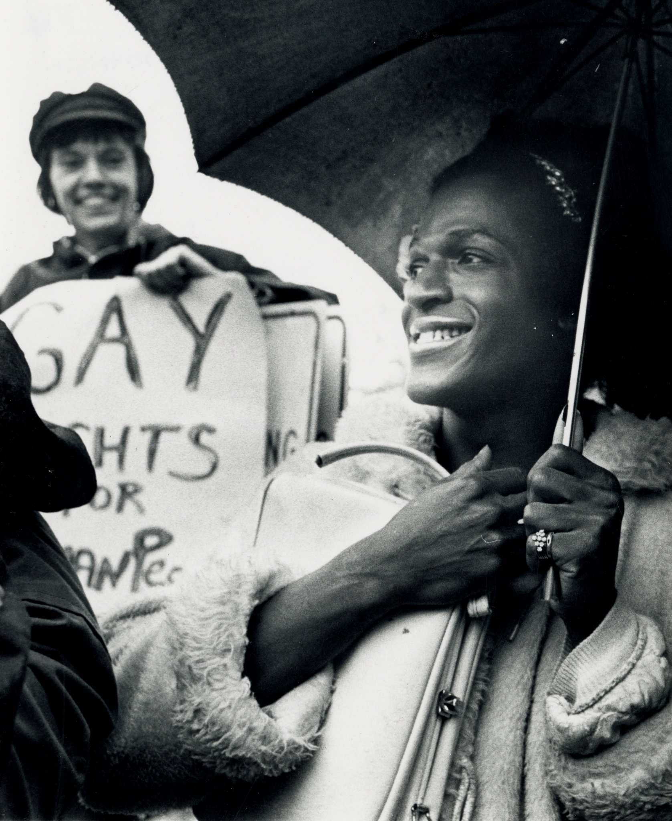
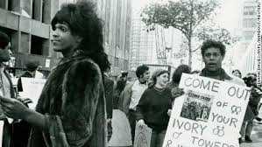
Activism
Following the Stonewall Riots, Marsha joined up with the Gay Liberation Front.
Marsha participated in marches to continue the momentum of the Stonewall uprising, and to demand an end to the persecution of the LGBTQ+ community.
At some point though, Marsha began to notice that the transgender community was not properly acknowledged or supported by the activists.
This prompted Marsha into action.
Notes:
Read the slide aloud for the students.

Slide 10
Reflect
Why do you think the LGBTQ+ activists were not welcoming or supportive of transgender and gender nonconforming individuals?
Notes:
Invite the students to engage in reflection.

Slide 11
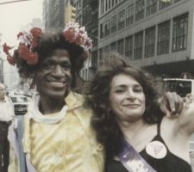
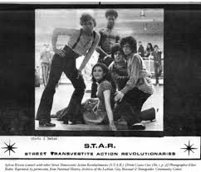
STAR
Due to the lack of support and activism for the transgender community, Marsha and her friend Syliva Rivera, founded STAR.
STAR was founded to be a shelter for gay and trans kids experiencing homelessness.
Marsha worked hard to provide food, clothing, emotional support and a sense of family for the young trans women, gender noncomformists, and other gay street kids.
Notes:
Read the slide aloud for the students.

Slide 12
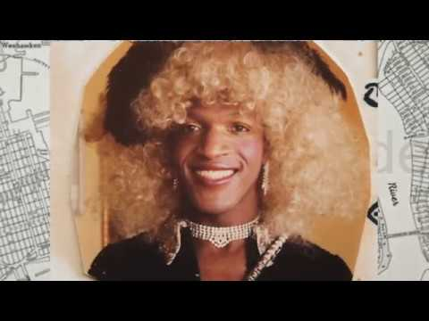
STAR
Notes:
Play the video for the students. At the present time, the term “transvestite” is outdated and considered derogatory. Remind the students.
5:25
https://youtu.be/MhGf-ba5Syw

Slide 13
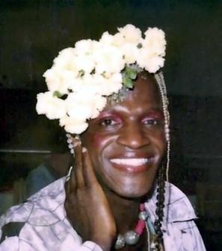
Suspicious Death
Shortly after the 1992 Pride Parade Marsha P. Johnson was found dead in the Hudson River.
Police initially ruled the death a suicide.
Marsha's friends and community members insisted she was not suicidal and demanded an explanation for the massive head wound suffered by Marsha.
Many witnesses stated they had seen Marsha being harassed that day by people using homophobic slurs.
Notes:
Read the slide aloud for the students. Emphasize that brutality against the transgender community continues to this day, especially transgender people of color.

Slide 14
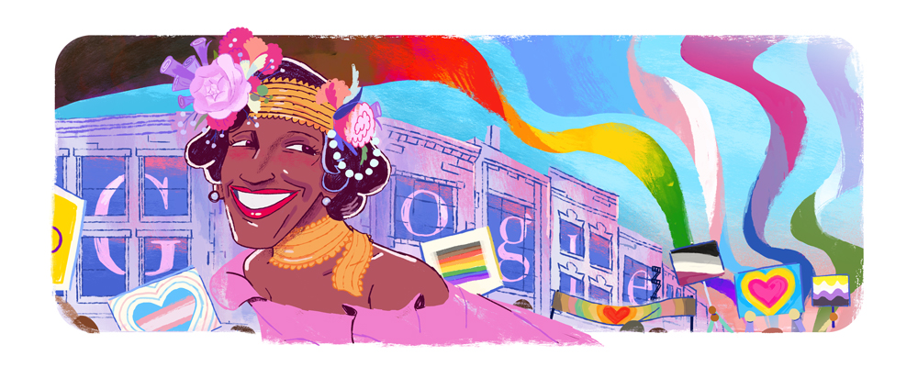
Legacy
Many credit Marsha P. Johnson's life and legacy as the foundation for Pride Month.
Marsha is recognized as a civil rights activist that "lived boldly, refusing to exist within gender boundaries".
Marsha spent her life fighting for the rights and equality of people living with HIV/AIDS.
Marsha is also recognized as the "definition of intersectionality" - a Black queer person who also dealt with mental health challenges.
The legacy of Marsha P. Johnson's life is encapsulated by "how she died, and persevered and managed to advocate for people when so few people were advocating for her".
Notes:
Read the slide aloud for the students.

Slide 15
Check Out
Would you rather watch a Horror film or a Comedy?
Horror
Comedy
Notes:
Engage the students in a check out

Slide 16
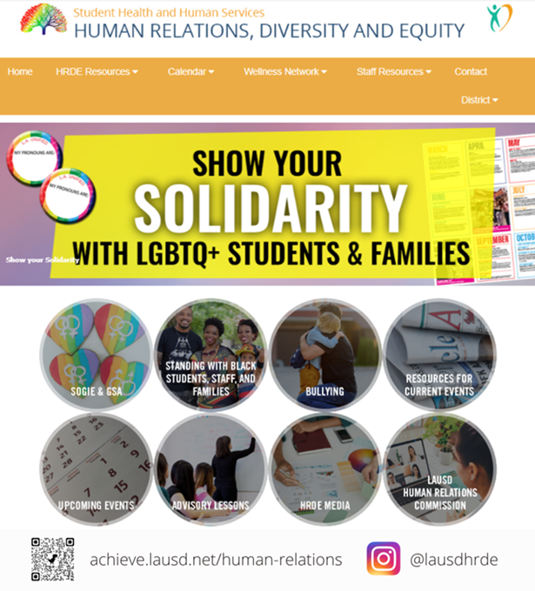
Human Relations, Diversity & Equity

Slide 17
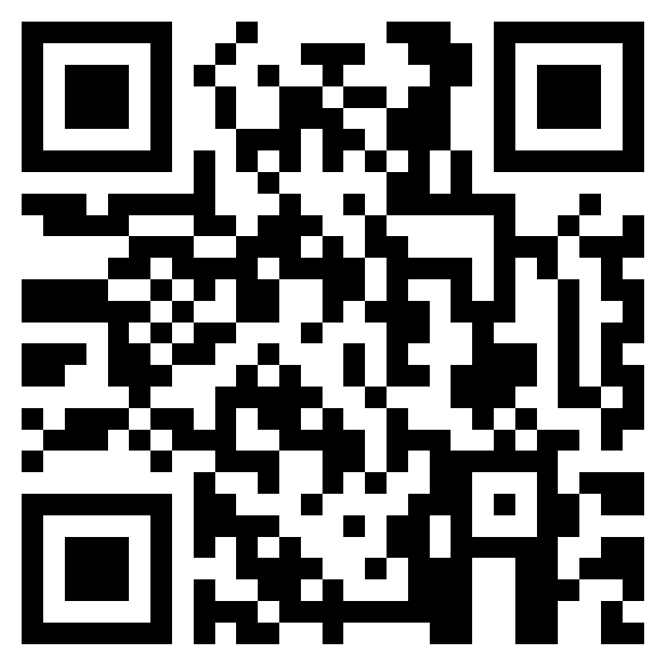
Teacher Feedback
Notes:
Teacher, please complete a brief feedback survey by scanning the QR code or using the link below.
https://forms.office.com/r/i9UqyyxzTT

